Slide 1


00
TutorsHub
Final Presentation

Slide 2

Vision Statement
01
TutorsHub
Student powered tutor-tutee app
Peer-to-peer collaboration proven to be a success
Effective help through hardships of college

Slide 3
02
DEMO

Slide 4
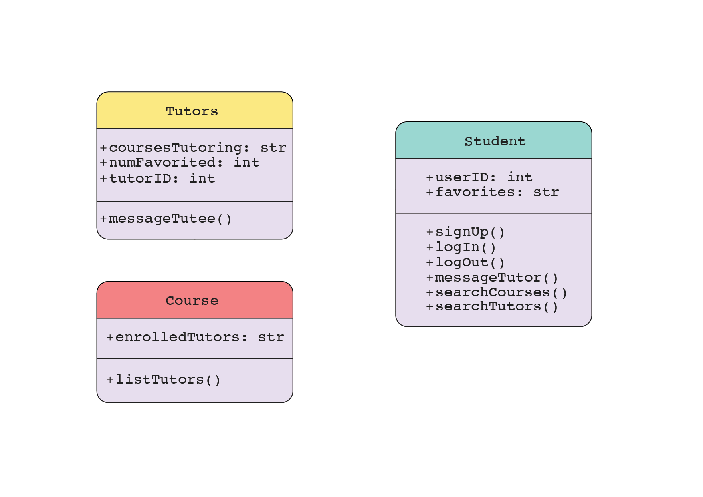
04
UML Diagram

Slide 5
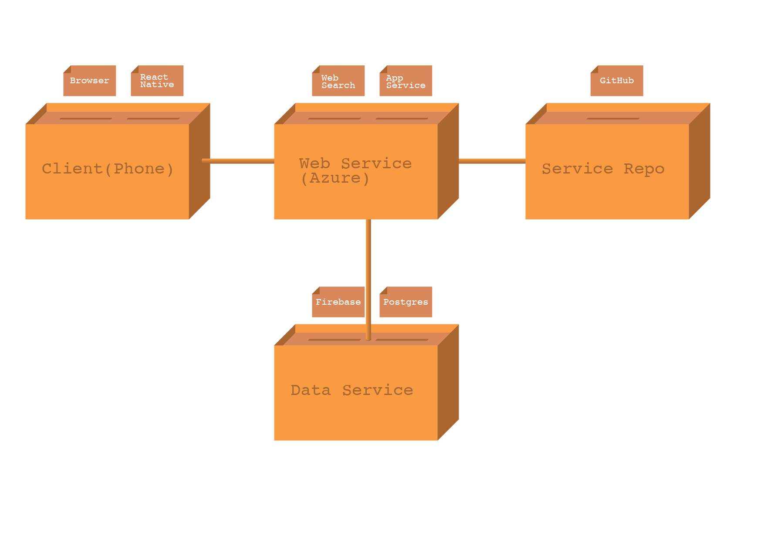
04
Deployment Diagram

Slide 6
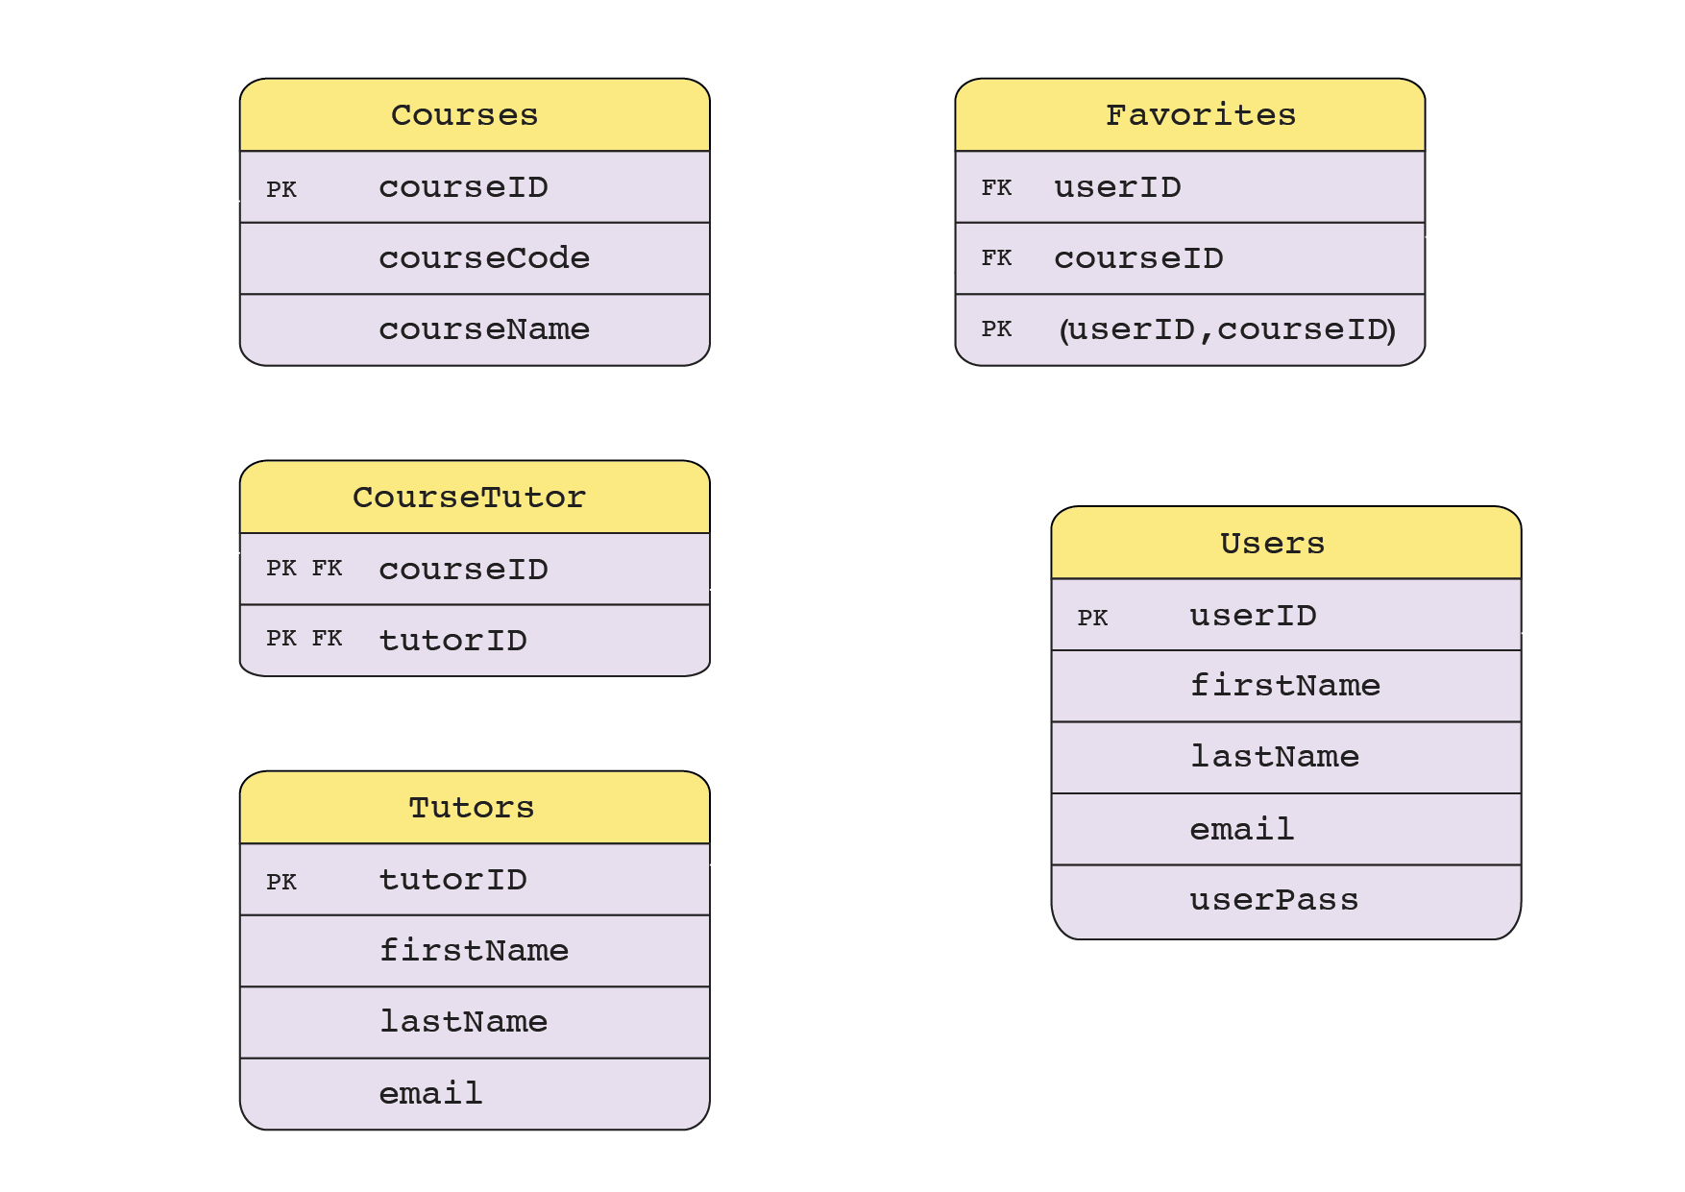
05
Current Database Schema

Slide 7



06
Weaknesses
Future Prospects
Strengths
More robust and consistent tutor evaluation system
Adding a more diverse class selection in the future
Not regulated
Not enough tutors to cover every class
Api has a limit
Matches students with peer tutors
Easy to use
Chat feature
Social Implications
Access to Education
Connectivity
Favorite Contest
Assessment

Slide 8
07
Conclusion

Slide 9
08
?
?
Q & A

